Slide 1
Module:3

Slide 2
Module:3 Supervised Learning – II
K-NN classifier – Logistic regression – Perceptron – Single layer & Multi-layer – Support Vector Machines – Linear & Non-linear – Metrics & Error Correction

Slide 3
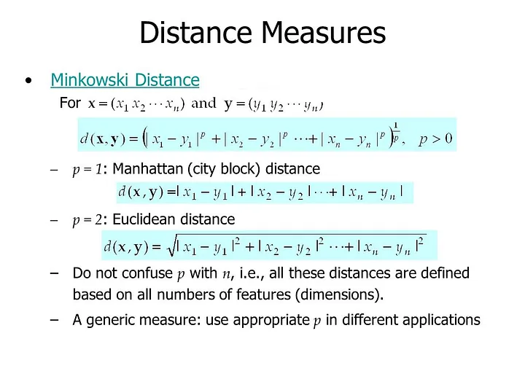
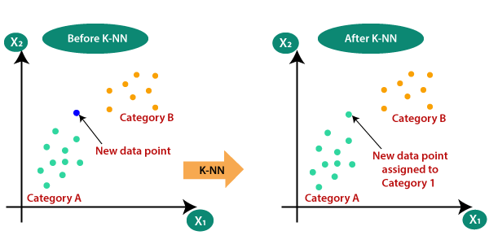
K-NN classifier
K-nearest neighbor (KNN) algorithm, is a machine learning algorithm that uses proximity to compare one data point with a set of data it was trained on and has memorized to make predictions

Slide 4
K-NN classifier
K-nearest neighbor (KNN) algorithm, is a machine learning algorithm that uses proximity to compare one data point with a set of data it was trained on and has memorized to make predictions
Pros:
Very easy to implement.
No separate training phase required.
Very useful to non-linear data.
Cons:
Prediction Can be slow if the training samples are more.
Computational is expensive because it store all training samples.
Sensitive to the choosen value of parameter K.

Slide 5
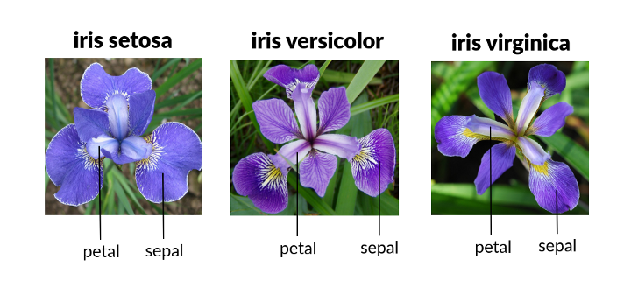
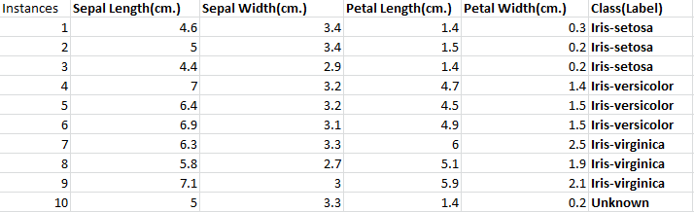
K-Nearest Neighbors algorithm (KNN)

Slide 6
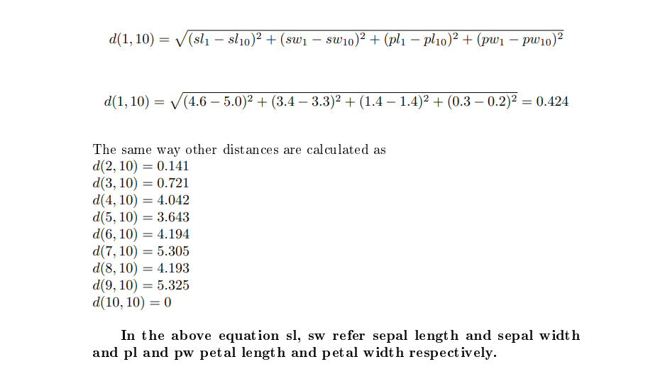

Slide 7
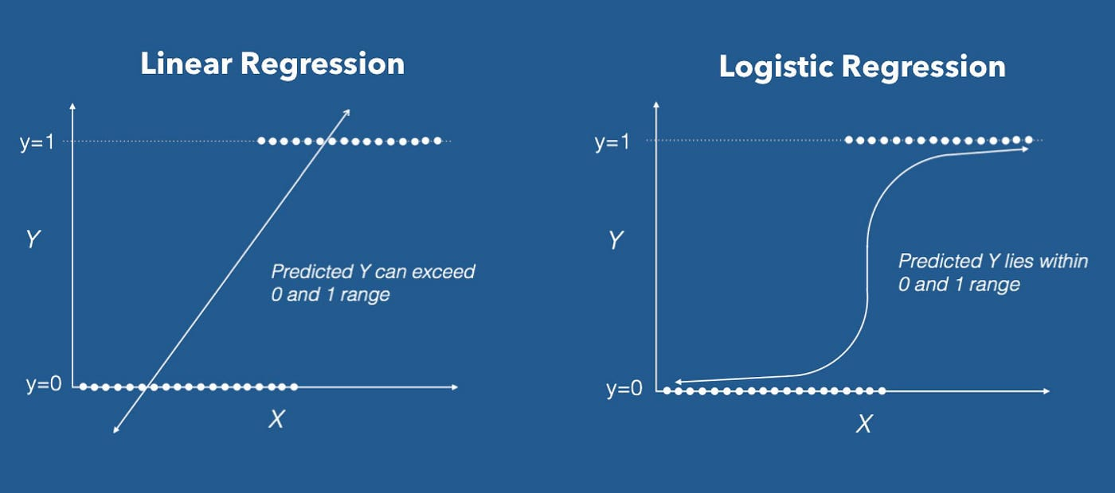
Logistic regression

Slide 8
Logistic regression
Regression analysis is a set of statistical processes for estimating the relationships between a dependent variable (often called the ‘outcome variable’) and one or more independent variable (often called ‘predictors’, ‘covariates’, or ‘features’).
Logistic Regression:
In statistics, the logistic model is used to predict the probability of certain class or event existing such as Pass/Fail, Win/Lose, etc.
Logistic regression is a statistical method used for binary classification problems, where the outcome can take one of two possible values. It's a type of regression analysis that models the probability of a binary outcome based on one or more predictor variables.

Slide 9
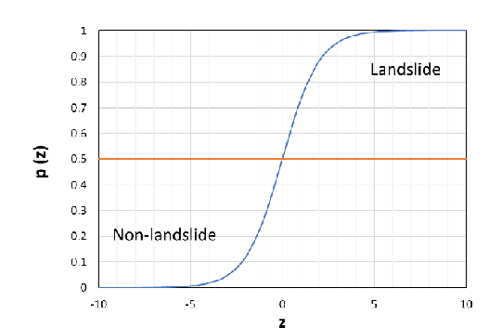
Logistic regression

Slide 10
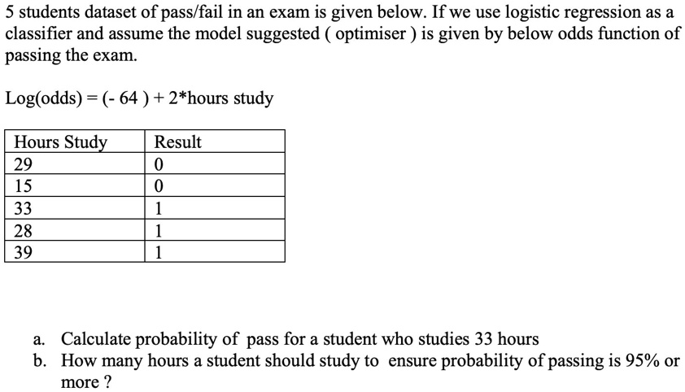
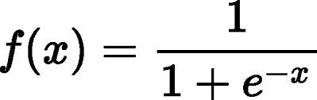
Logistic regression
Sigmoid function

Slide 11

Support Vector Machine (SVM)
Support Vector Machine (SVM) is a powerful supervised machine learning algorithm well-suited for classification problems
Hyperplane: A decision boundary that separates data points.
Margin: The distance between the hyperplane and the closest data points (support vectors).
Support vectors: Data points that influence the position of the hyperplane.
Margin Maximization: The goal is to maximize the distance between the hyperplane and the closest data points from each class (support vectors).

Slide 12
Simple SVM
A support vector machine (SVM) is a type of supervised machine learning classification algorithm.
SVMs were introduced initially in 1960s and were later refined in 1990s.
In case of linearly separable data in two dimensions, a typical machine learning algorithm tries to find a boundary that divides the data in such a way that the misclassification error can be minimized.
There can be several boundaries that correctly divide the data points. The two dashed lines as well as one solid line classify the data correctly.

Slide 13
Simple SVM
SVM differs from the other classification algorithms in the way that it chooses the decision boundary that maximizes the distance from the nearest data points of all the classes.
An SVM doesn't merely find a decision boundary; it finds the most optimal decision boundary.
The most optimal decision boundary is the one which has maximum margin from the nearest points of all the classes.
SVMs are one of the most robust prediction methods, being based on statistical learning frameworks or VC theory

Slide 14
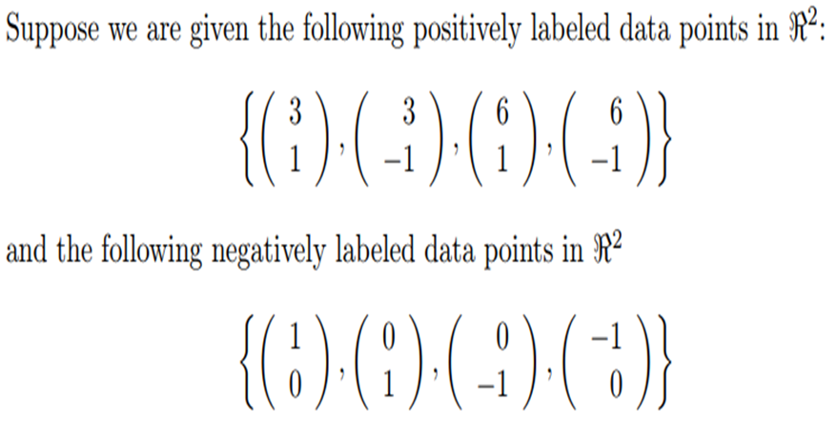
SVM by Example –Linearly separable data

Slide 15
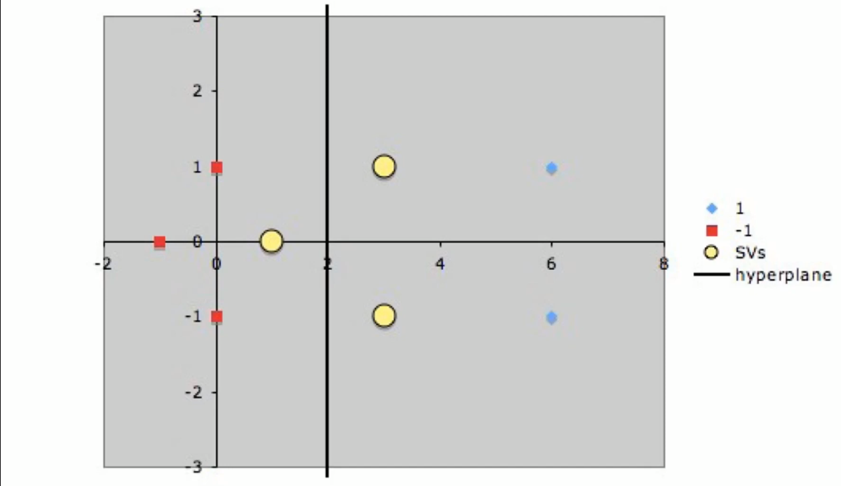
Hyperplane

Slide 16
SVM Example - 2
Construct a linear discriminant with :
Positive samples : (1,1) , (1,-1), (2,1), (2,-1)
Negative samples : (4,0) , (6,0), (5,1), (5,-1)

Slide 17
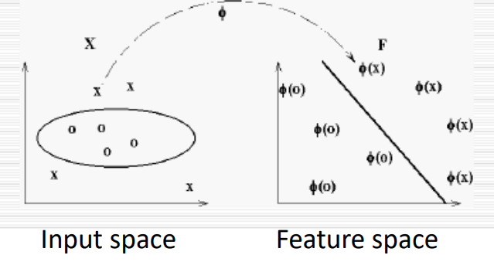
Non-linear SVM
Problem: Some data are not linear separable.
Intuition: to transform the data to a high dimension space

Slide 18
Perceptron
A single perceptron is the foundational unit of artificial neural networks. Inspired by the biological neuron, it's a simple computational model capable of performing basic classification tasks.
Inputs: It receives multiple input values, often numerical.
Weights: Each input is multiplied by a corresponding weight, representing its importance.
Summation: The weighted inputs are summed together.
Activation Function: The sum is passed through an activation function (e.g., step function, sigmoid, ReLU) to produce an output.
Linear Classifier: A perceptron can only classify linearly separable data, meaning it can divide data points into two classes using a straight line.
Applications: While limited in complex tasks, single perceptrons can be used for:
Basic pattern recognition
Simple decision-making
Logical operations (AND, OR, NOT)

Slide 19
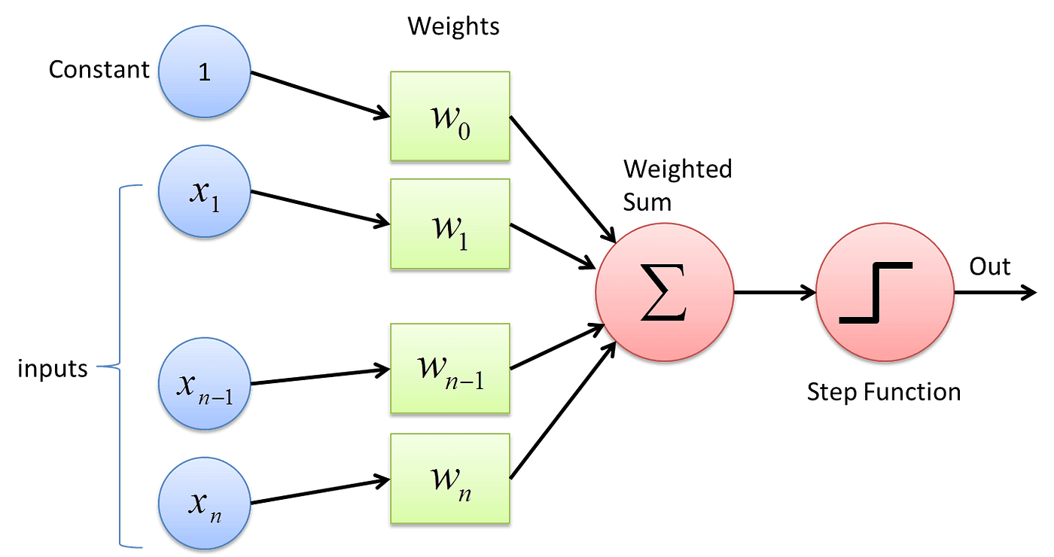
Perceptron
Wo- Bias

Slide 20
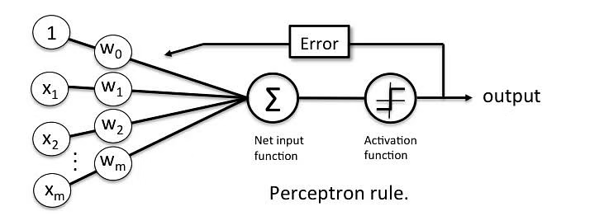
Perceptron

Slide 21
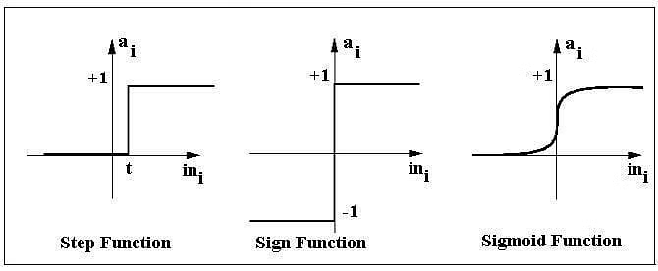
Perceptron

Slide 22
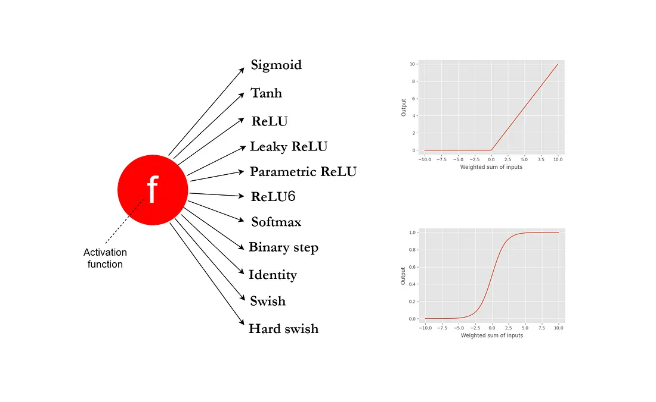
Perceptron

Slide 23
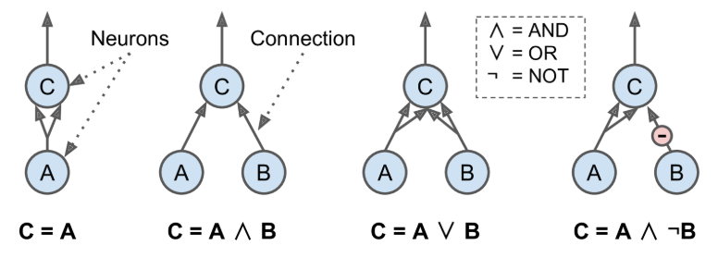
ANN performs simple Logical Computations
1. Identity function: If neuron A is activated, then neuron C gets activated as well (since it receives two input signals from neuron A), but if neuron A is off, then neuron C is off as well.

Slide 24
2. Logical AND: Neuron C is activated only when both neurons A and B are activated (a single input signal is not enough to activate neuron C).
3. Logical OR: Neuron C gets activated if either neuron A or neuron B is activated (or both).
4. Computes a slightly more complex logical proposition: Neuron C is activated only if neuron A is active and if neuron B is off. If neuron A is active all the time, then you get a logical NOT: neuron C is active when neuron B is off, and vice versa.

Slide 25
The Perceptron
The Perceptron is one of the simplest ANN architectures, invented in 1957 by Frank Rosenblatt.
It is based on a slightly different artificial neuron called a linear threshold unit (LTU).
The inputs and output are now numbers (instead of binary on/off values) and each input connection is associated with a weight.
The LTU computes a weighted sum of its inputs (z = w₁ x₁ + w₂ x₂ + ⋯ + w_{n} x_{n} = w^{T} · x), then applies a step function to that sum and outputs the result: h_{w}(x) = step (z) = step (w^{T} · x).

Slide 26
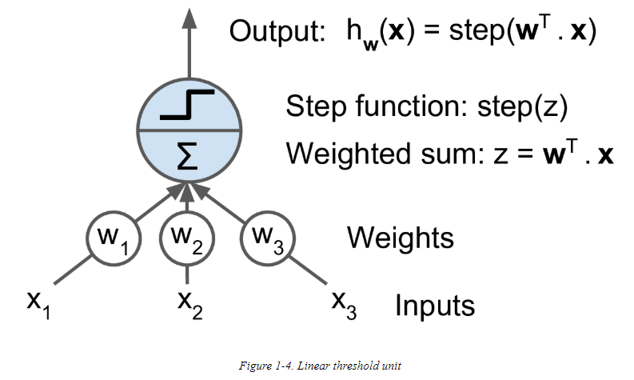
The Perceptron -linear threshold unit (LTU) or Threshold logic unit(TLU) .

Slide 27
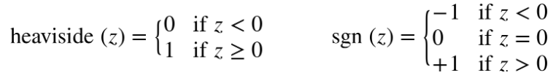
The most common step function used in Perceptrons is the Heaviside step function, sometimes the signum function is used instead.
A single LTU can be used for simple linear binary classification.
It computes a linear combination of the inputs and if the result exceeds a threshold, it outputs the positive class or else outputs the negative class (just like a Logistic Regression classifier or a linear SVM).

Slide 28
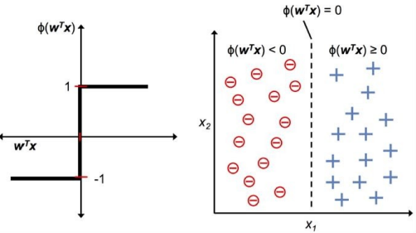
Perceptron
Perceptron has the following characteristics:
– Perceptron is an algorithm for Supervised Learning of
single layer binary linear classifier.
– Optimal weight coefficients are automatically learned.
– Weights are multiplied with the input features and decision
is made if the neuron is fired or not.
– Activation function applies a step rule to check if the
output of the weighting function is greater than zero.
– Linear decision boundary is drawn enabling the distinction
between the two linearly separable classes +1 and -1.
– If the sum of the input signals exceeds a certain threshold,
it outputs a signal; otherwise, there is no output.

Slide 29
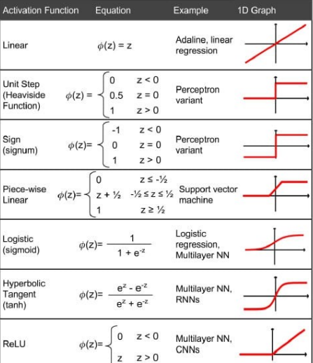
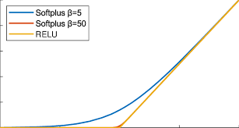

Slide 30
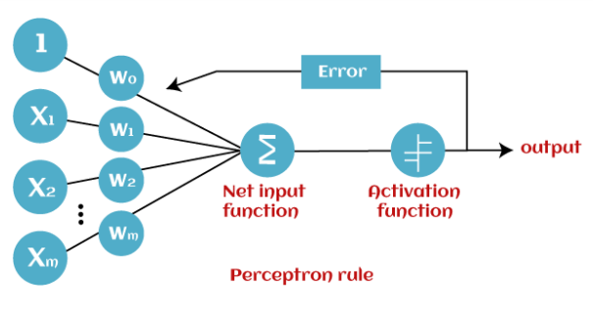
Perceptron Rule
Forward Stage: Activation functions start from the input layer in the forward stage and terminate on the output layer.
Backward Stage: In the backward stage, weight and bias values are modified as per the model's requirement. In this stage, the error between actual output and demanded originated backward on the output layer and ended on the input layer.

Slide 31
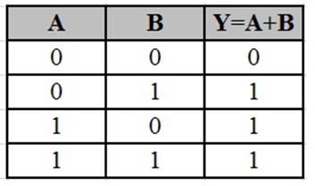
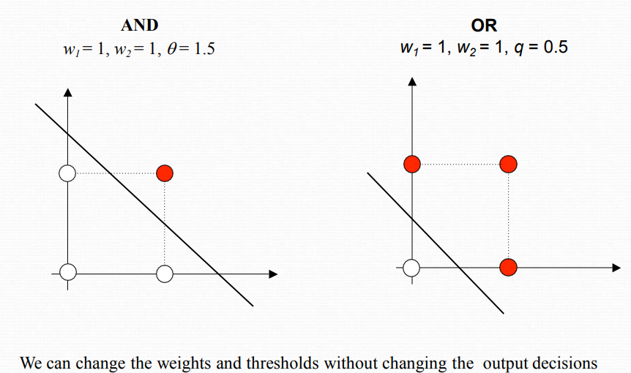
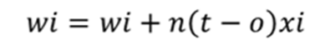
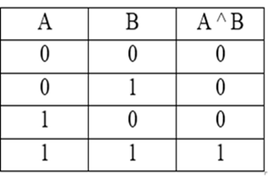
Truth Table of OR Logical GATE
Decision Boundary for AND and OR
Truth Table of AND Logical GATE

Slide 32
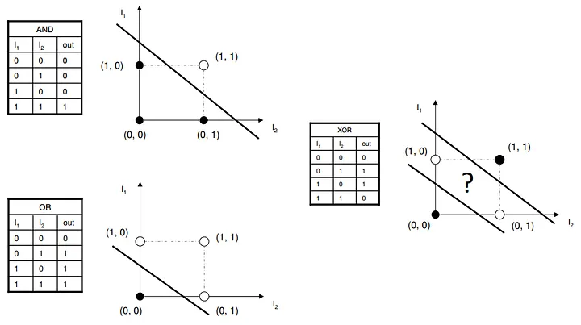
Decision Boundary for XOR

